Slide 1
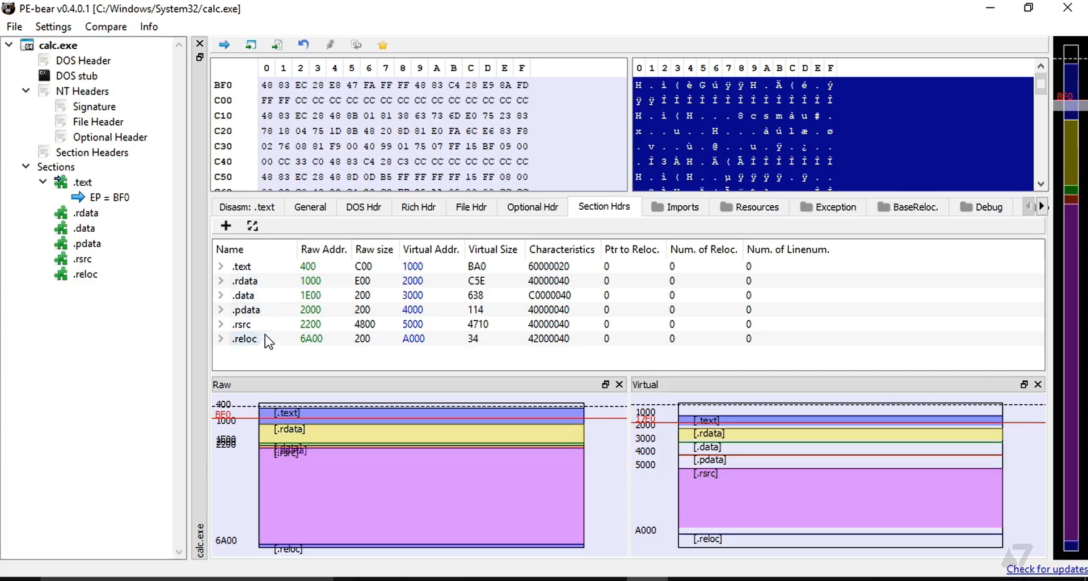

Analyzing PE File Format
Dr: Nabil Ismail By :Amira Mohamed Menshawy

Slide 2
https://github.com/hasherezade/pe-bear/releases
Download the appropriate version for your device from here, then unzip the file and run the .bat file to run PE-Bear.
Example Activity: Parse a PE file using a tool like PE-bear or manually using a hex editor to locate the entry point and imported functions.
Objective:
Analyze a PE (Portable Executable) file format to understand its structure, locate the entry point, and identify imported functions.
The goal is to inspect how the executable is structured, including headers, code, and data, to learn how reverse engineers extract critical information like entry points and library dependencies.
Tools Needed:
PE-bear (since you've already installed it)
This tool will allow you to analyze the PE file’s internal structure, headers, entry point, and imported functions.
Hex Editor (Optional, if needed for manual analysis)
HxD or another hex editor to inspect the raw byte data of the file.

Slide 3
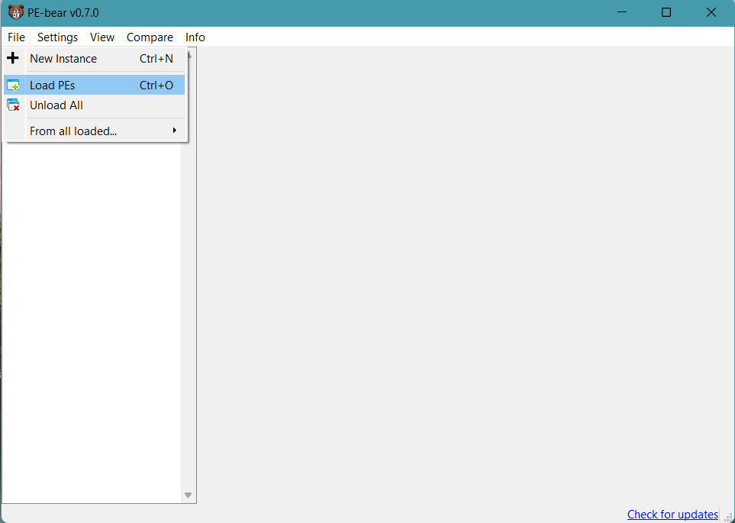
Open the PE File
Action: In PE-bear, go to File > Open and select the .exe or .dll file you wish to analyze.

Slide 4
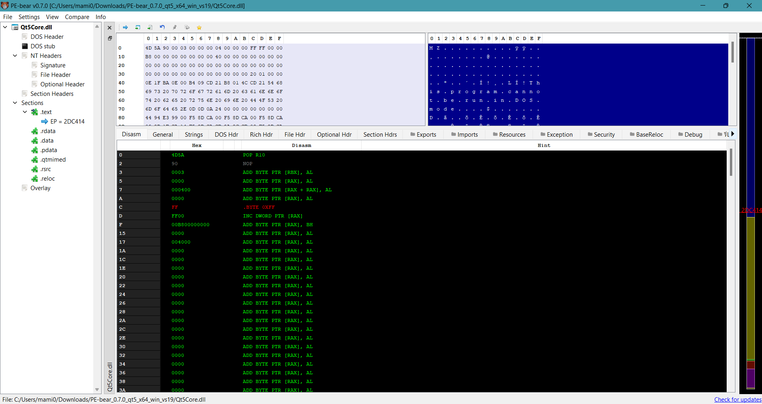
Inspect the PE Headers
Objective: The first part of the PE file is the DOS Header, followed by the PE Header.
In PE-bear:
You will see the DOS Header (starts with MZ), followed by the PE Header (PE).
Note: These headers contain vital information like the architecture type, the entry point, and the location of other sections.

Slide 5
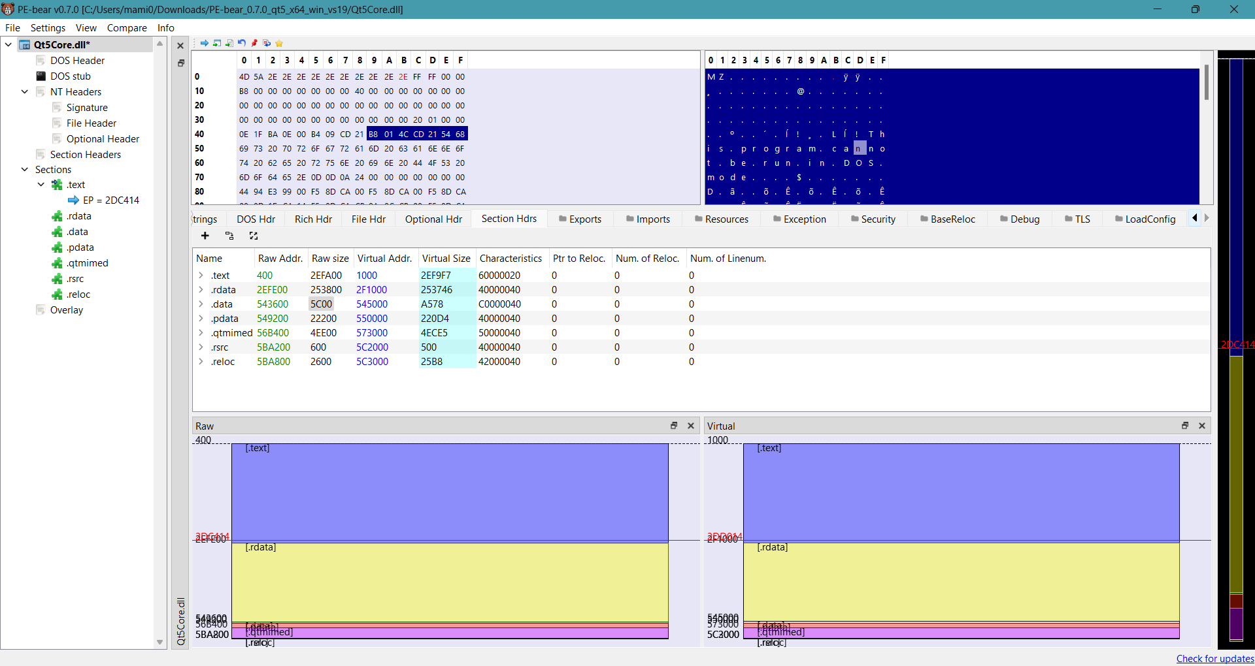
Locate the Entry Point
Action: In PE-bear, look for the Entry Point (the address where execution begins) in the PE header or navigate to the "Entry Point" section of the tool.
Objective: The entry point is a critical location where the executable starts its execution. Understanding the entry point helps you know where the program begins to interact with the system.

